Slide 1

Predicting Student Success: A Statistical Analysis of Academic Performance Factors
Kim Lu, Sherine Tumushemeze, Gorkem Dural, and Augustine Ezirim

Slide 2
INTRODUCTION
Why it Matters Academic performance is a growing concern for educators and policymakers. Early identification of at-risk students enables timely support and reduces dropout rates.
Approach
Logistic Regression: Predicts pass/fail outcome.
Principal Component Analysis (PCA): Identifies key underlying factors.
Decision Tree: Visualizes how variables interact to predict success.
Significance Demonstrates the power of statistical learning and data-driven insights in education to inform interventions and improve student outcomes.
Objective Predict whether a student will pass their final grade (G3 ≥ 10) using demographic, academic, and behavioral data.

Slide 3
DATASET
The dataset used in this study contains comprehensive information on secondary school students, with variables that capture their academic history, demographic background, and lifestyle habits
The primary outcome of interest is whether a student passes the course, which is defined as achieving a final grade (G3) of 10 or higher.
To support this analysis, we created a binary target variable (Pass) where students with G3 ≥ 10 are classified as passing and those with G3 < 10 as failing.
the dataset is relatively clean, with no missing values and a manageable number of observations for statistical modelling.

Slide 4

Decision Tree Classification

Slide 5
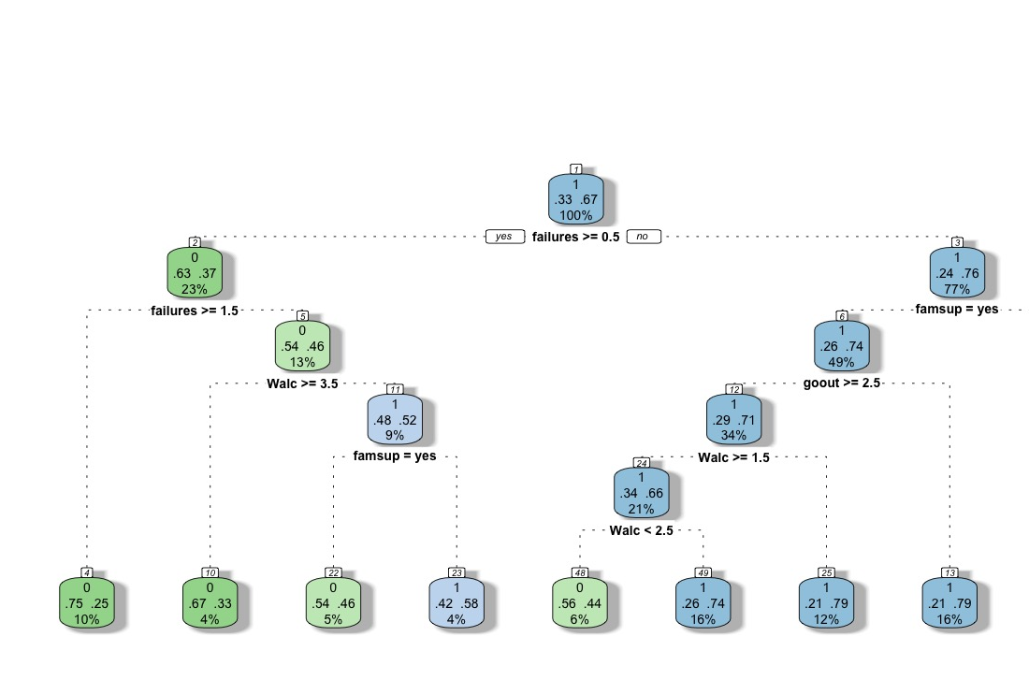
Unpruned Tree
Top Split: Prior failures = strongest predictor
Pass Rate: 76% if no failures
Other Factors: Alcohol use, going out, and family support
Insight: Academic history + behavior influence outcomes

Slide 6
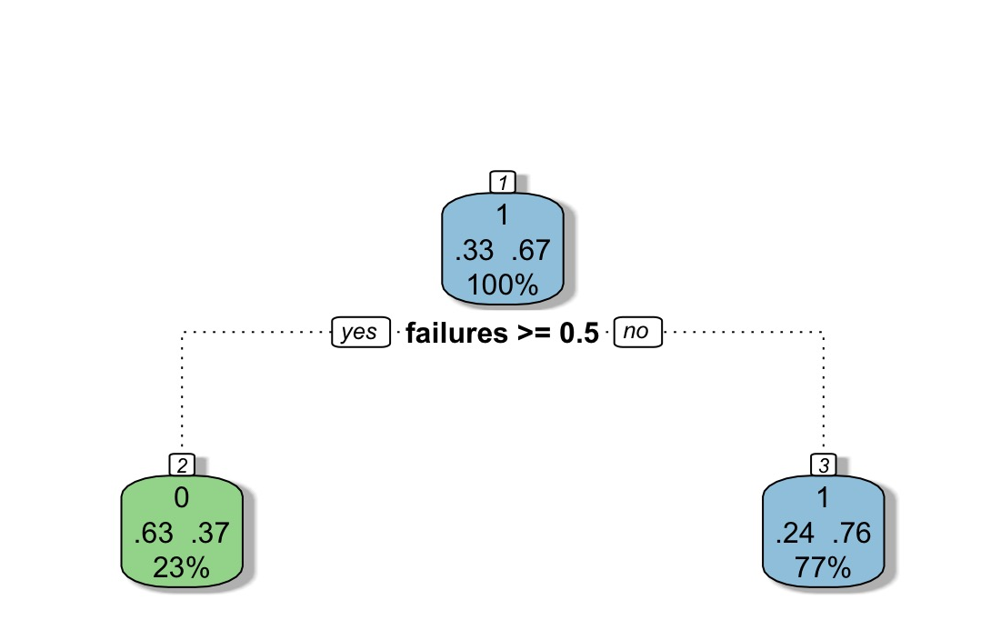
Pruned Tree
Single Split: Based on past failures
Result:
Students with no failures → 76% chance of passing
Students with 1+ failures → only 37% pass rate
Conclusion: Academic history is the strongest predictor of success

Slide 7
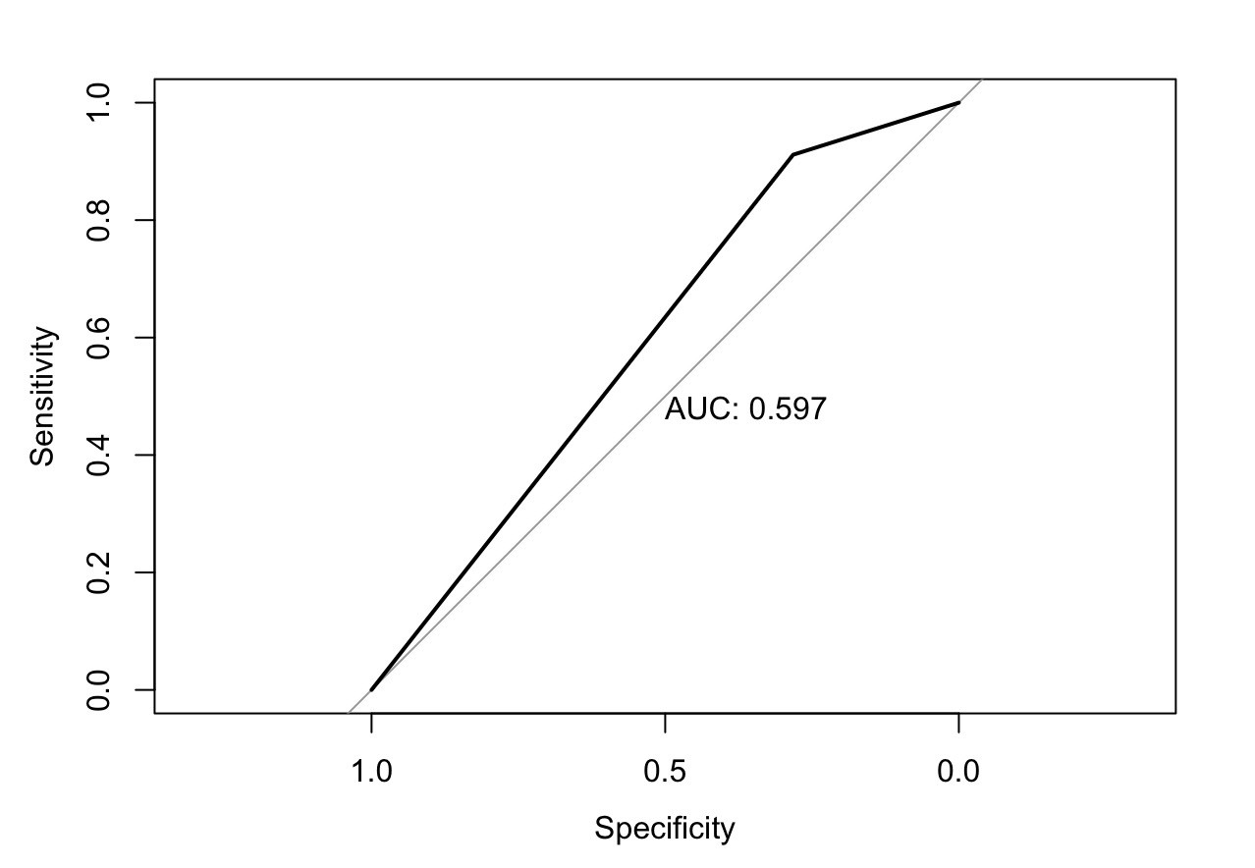
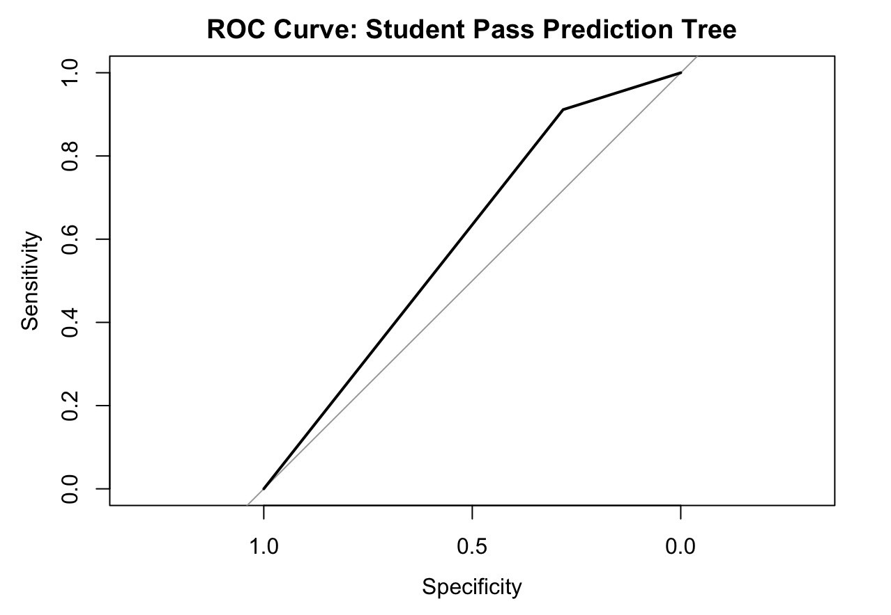
MODEL EVALUATION (ROC Curve)
The ROC curve illustrates the model’s ability to distinguish between students who passed and those who failed.
AUC = 0.597, indicating modest predictive power.
High specificity but low sensitivity, meaning the model correctly identifies most students who pass but misses many who fail.
Suggests room for improvement in detecting at-risk students.

Slide 8
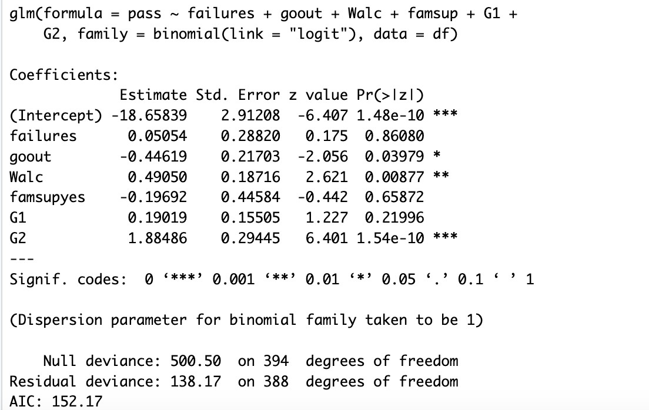
Logistic Regression Outcomes
Significant Predictors:
goout (p = 0.0398): Going out negatively impacts pass probability
Walc (p = 0.00877): Higher alcohol use reduces likelihood of passing
G2 (p < 0.001): Strongest predictor of final outcome
Interpretation: Social habits and prior academic performance (G2) strongly influence student success
Model Fit: AIC = 152.17 → relatively strong model Residual deviance dropped from 500.5 to 138.17

Slide 9
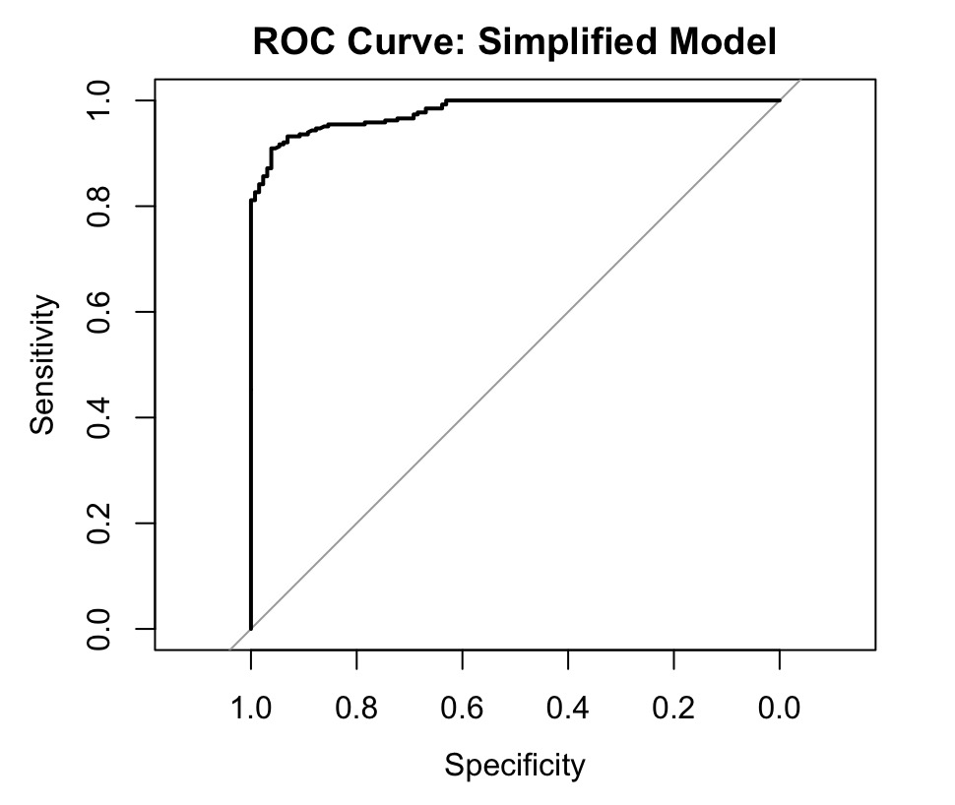
ROC Curve
Model Type: Simplified logistic regression
Strong Performance: Curve hugs the top-left → high true positive rate and low false positive rate
Interpretation: Model effectively distinguishes between pass/fail outcomes

Slide 10

Principal Component Analysis

Slide 11
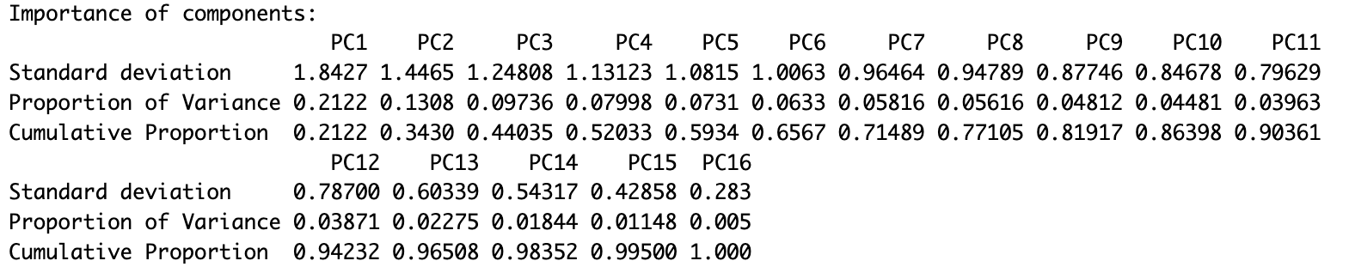
Proportion of Variance
PC1 represents a "general academic achievement" dimension. PC2 captures a "behavioral/lifestyle" dimension.
The first five components (PC1 to PC5) explain 59.34%, while threshold is from PC1 to PC12 with 94.23%.
As it can be seen, data has no single dominant feature, variance spread across many PCs.
This suggests a moderate multicollinearity structure where several variables contribute meaningfully to the overall variability.

Slide 12
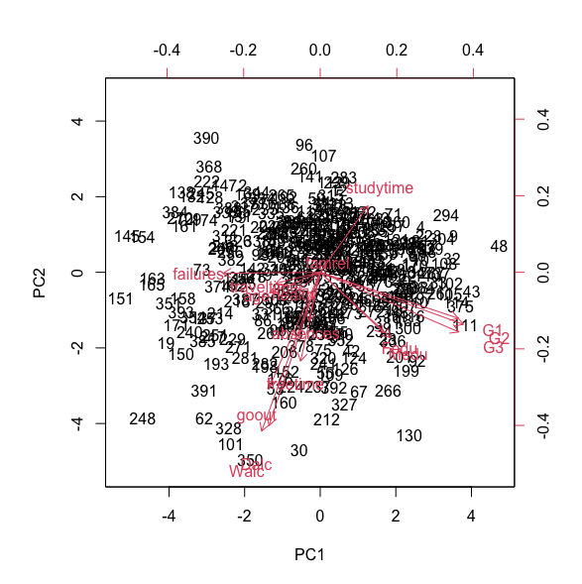
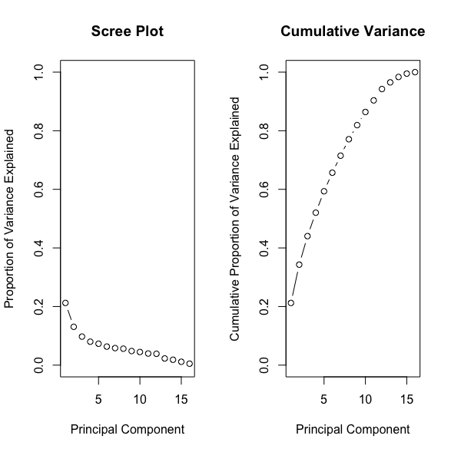
Scree Plot and Cumulative Variance
Black points here shows individual students. Red arrows are the original variables projected onto the PC1-PC2 space.
Failures, G1, G2, G3 (grades and failure) are strongly aligned, suggesting they contribute similarly and heavily to PC1.
Studytime also points in a similar direction, indicating it’s positively associated with higher performance (G1–G3).

Slide 13

Conclusion

Slide 14
Among the three modeling approaches, logistic regression emerged as the most accurate, achieving a 92.41% accuracy rate and an AUC of 0.912, indicating excellent discriminatory ability.
The variable G2 (second-period grade) was the strongest predictor.
The decision tree classifier, while offering interpretability, achieved a lower accuracy of 70.3%, with an AUC of 0.597, and was particularly limited in sensitivity (28.2%).
The first three principal components captured over 44% of the total variance, and the top seven explained more than 71%..

Slide 15

Recommendation

Slide 16

Use G2 Grades for Early Intervention → Mid-semester performance strongly predicts final success → Act early with academic support and counseling
Target Students with Past Failures → Prior failures signal high risk → Offer mentoring, tutoring, or lighter course loads
Monitor Social Habits → Frequent outings hurt performance → Promote balance through wellness and time management programs
Engage Families → Parental education and support matter → Involve families via workshops and consistent communication
Adopt Predictive Tools in Schools → Logistic regression reached 92% accuracy → Build dashboards to flag and support at-risk students
Expand & Validate → Test models in different schools and countries → Ensure fairness and broader impact

Slide 17

Thank You

